Slide 1


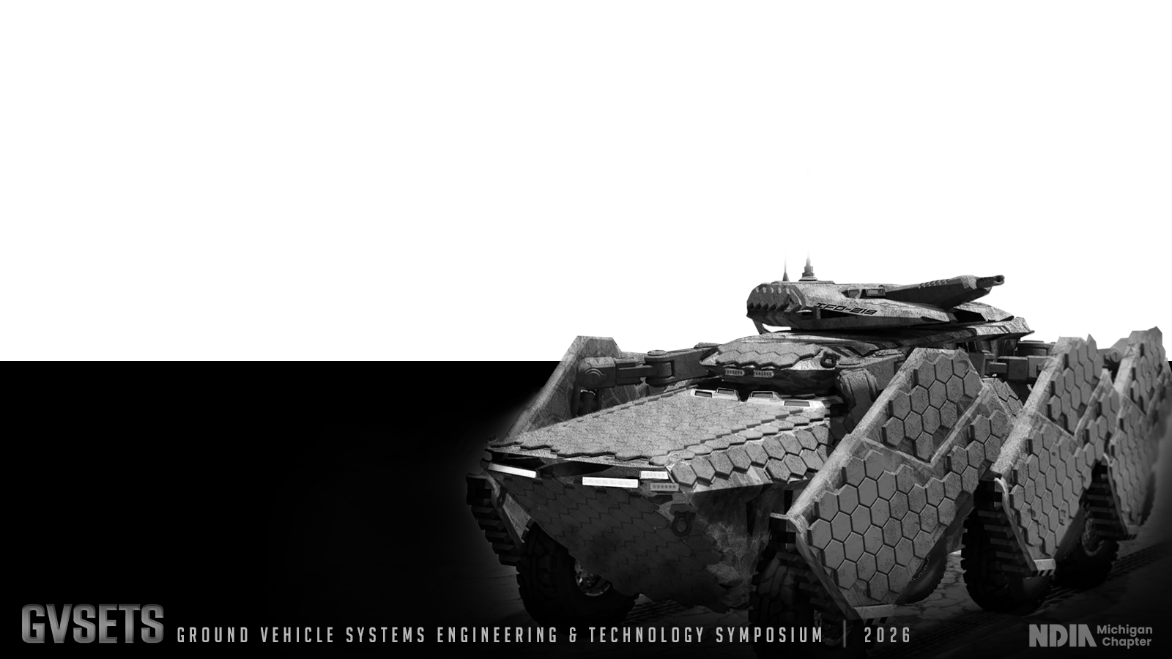
Electrical and Power Quality Performance Evaluation of a SiC Based 500kW High Temperature and High Power-Density Inverter
POWER & MOBILITY
Arash Sadigh Ph.D., Iris Shiroma
DISTRIBUTION STATEMENT A.
Approved for public release; distribution is unlimited. OPSEC #10906

Slide 2
Agenda
POWER & MOBILITY
Company Overview
DC-1000 Inverter Overview
Power Quality Performance Evaluation
Conclusion and Future Steps
DISTRIBUTION STATEMENT A. Approved for public release; distribution is unlimited. OPSEC #10906

Slide 3





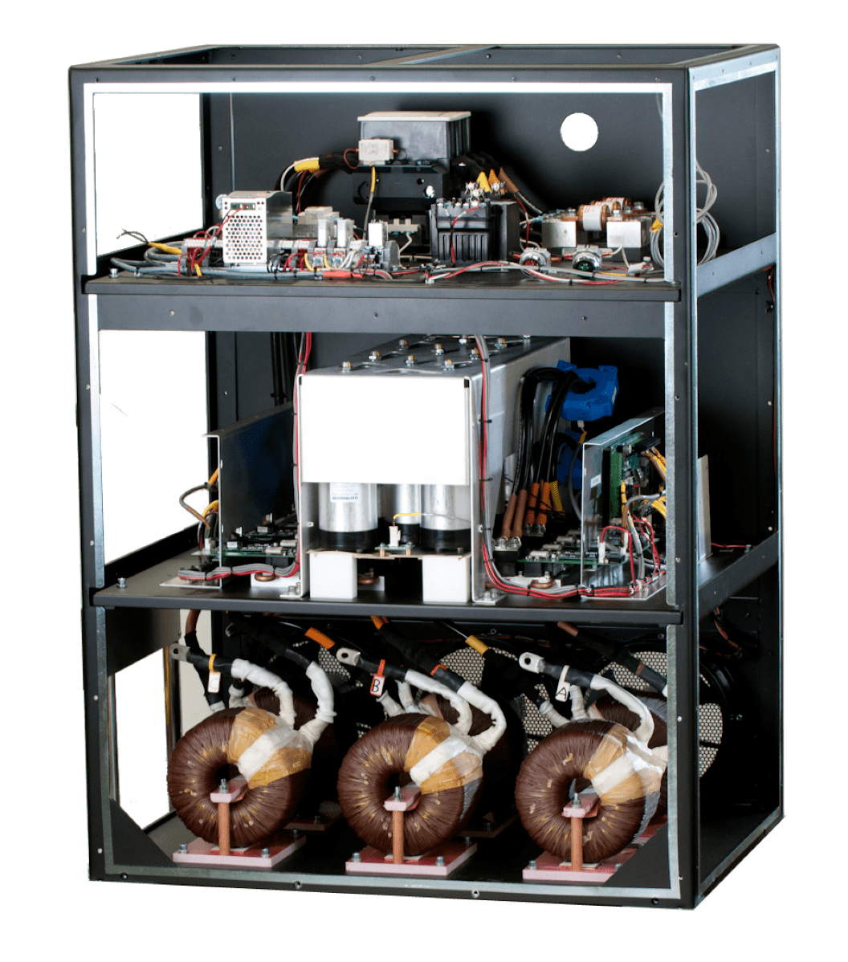
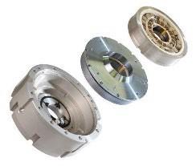
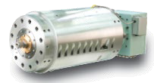



Calnetix Technologies Core Competencies
POWER & MOBILITY
Motor Generators
Power Electronics
Active Magnetic Bearings (AMB)
Ranging from a few watts to megawatt power levels with speeds ranging from 4,000 to 450,000 RPM
Meet most stringent utility and grid requirements and are available with maximum current ratings up to 1200A
Use permanent magnet bias homopolar design bearings and electromagnetic bias heteropolar design bearings
Ultraforce
Magnaforce
Vericycle Modules
Vericycle Bidirectional Drives
Powerflux
  Xcelflux
DISTRIBUTION STATEMENT A. Approved for public release; distribution is unlimited. OPSEC #10906

Slide 4
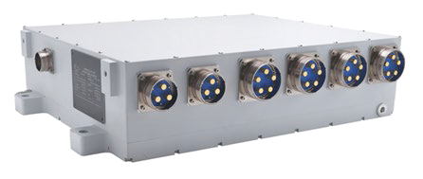
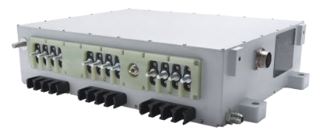
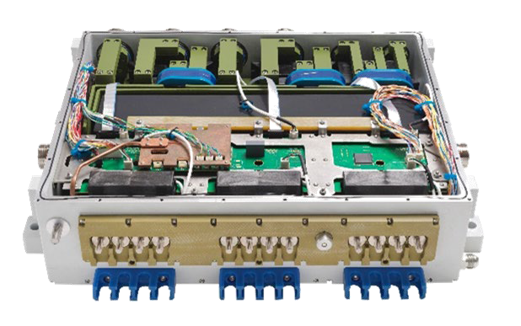
System Overview – EnercycleTM DC-1000 InverterPOWER & MOBILITY
Volume: 2712 in³ (18.3” x 22.8” x 6.5”)
Weight = 240 lb
Current Rating (ac): 800 A_{rms}, 1000 A_{rms} transient
DC bus voltage range: 565 to 635 V_{dc}
Coolant: EGW @ 36 LPM, 105°C
Temperature: -40 to 121°C
Developed for the ground vehicle system
center (PEM)
(GVSC) platform electrification mobility program
Parallel operation of two SiC half-bridge modules (rated at 1200V 800A) in each phase, switching at 20kHz
Designed to meet ATPD-2404
requirements for rain/snow, and
shock/vibration, immersion, washdown
Communicates load, control, and diagnostics data to the host vehicle platform via SAE J1939 CAN
interface
Fig. 1: Enercycle DC-1000 Inverter
DISTRIBUTION STATEMENT A. Approved for public release; distribution is unlimited. OPSEC #10906

Slide 5
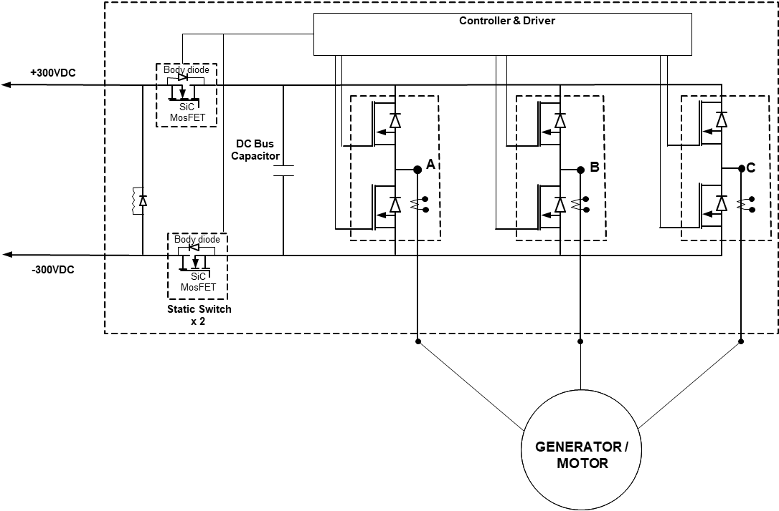
System Overview – EnercycleTM DC-1000 InverterPOWER & MOBILITY
Universal bi-directional ac/dc inverter for motoring and generating mode operation
High-frequency silicon-carbide (SiC) power switching devices
High-voltage dc and ac safety interlocks (HVIL)
High-speed DSP motor control utilizing speed sensor or sensor-less control algorithms
Three individually controlled (on/off) dc output/input
Supports parallelization of inverters for increased power capacity
Exceeds 11 kW per Liter, including the dc bus protection devices
Fig. 2: Enercycle DC-1000 inverter architecture.
DISTRIBUTION STATEMENT A. Approved for public release; distribution is unlimited. OPSEC #10906

Slide 6
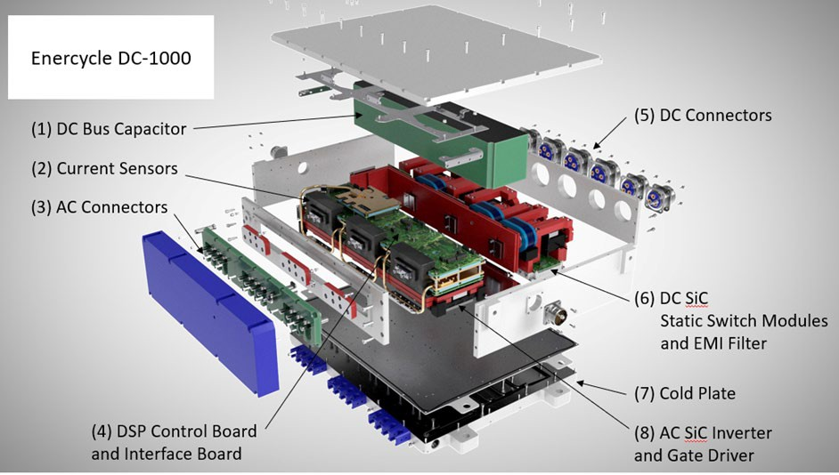
System Overview – EnercycleTM DC-1000 InverterPOWER & MOBILITY
Fig. 3: An exploded view of the EnercycleTM DC-1000 Inverter. (1) DC Bus Capacitor. (2) Current sensors. (3) AC Connectors. (4) DSP Control Board and Interface Board. (5) DC Connectors. (6) DC SiC Static Modules.
(7) Cold Plate. (8) SiC MOSFET Devices and Gate Drivers.
DISTRIBUTION STATEMENT A. Approved for public release; distribution is unlimited. OPSEC #10906

Slide 7
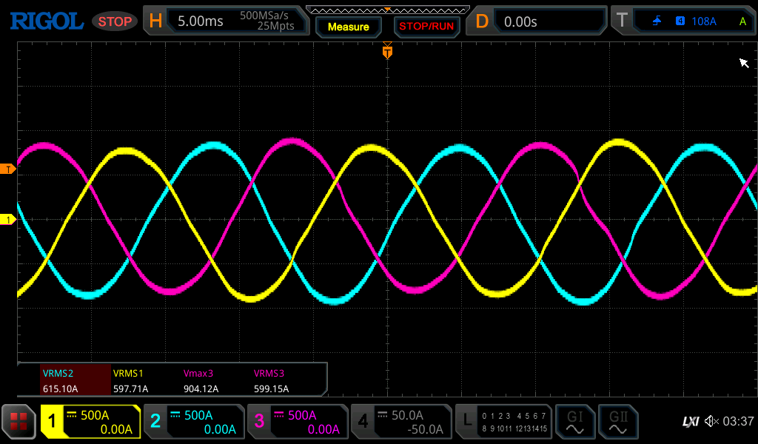
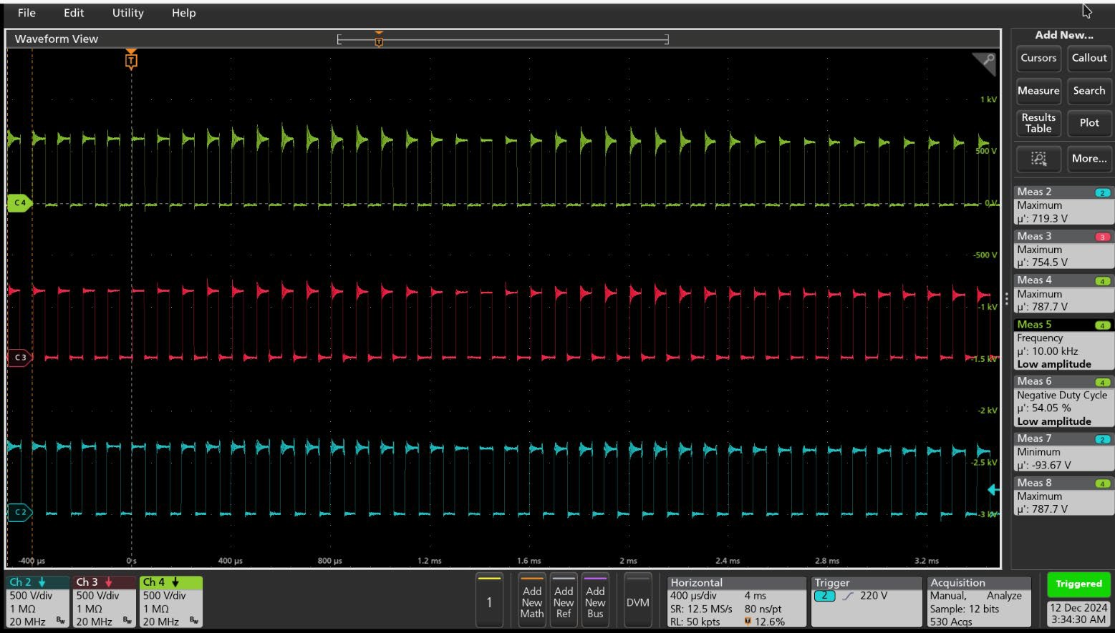



Electrical Performance
POWER & MOBILITY
Added snubber circuit to reduce Vds overshoot during turn-off transition
  Tested with inductive load
  To ensure the safe operation of SiC devices with enough margin
Fig. 5: Output phase currents of Enercycle DC-1000 Inverter tested with inductive load.
Test Conditions:
  Input DC Voltage: 600 V
  Output AC Current: 600 A_{rms}
Observed max Vds: 787 V.
Fig. 4: Drain to source voltage (Vds) across the SiC devices in each phase of Enercycle DC-1000 Inverter.
DISTRIBUTION STATEMENT A. Approved for public release; distribution is unlimited. OPSEC #10906

Slide 8
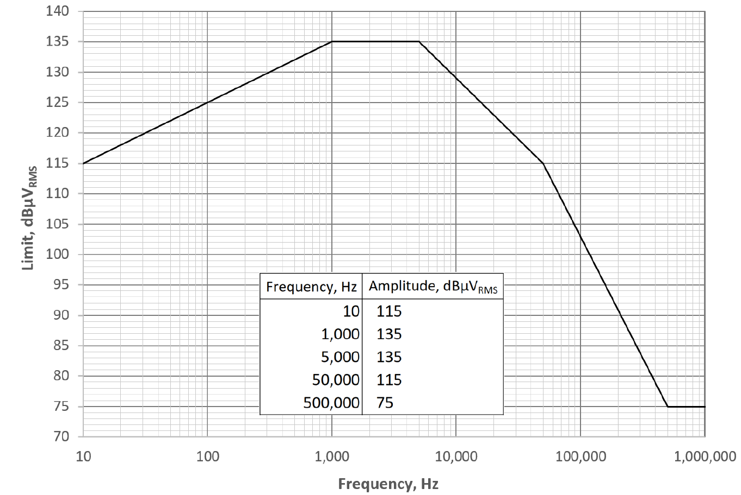
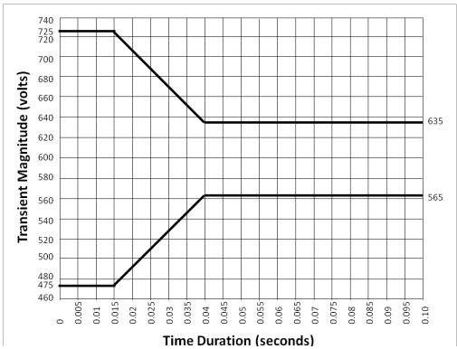
Power Quality Performance Requirements
POWER & MOBILITY
Requirements per MIL-PRF-GCS600A :
Steady state average value: 565 V – 635 V (600V ±35 V)
Steady state ripple peak to peak: +/- 9V
Distortion factor: 0.015
Distortion spectrum: see Fig. 1
Step load transient: see Fig. 2
Fig. 6: Envelope of distortion spectrum for 600 Vdc system based on MIL-PRF-GCS600A.
Fig. 7: Envelope of normal transients for 600 Vdc system based on MIL-PRF-GCS600A.
DISTRIBUTION STATEMENT A. Approved for public release; distribution is unlimited. OPSEC #10906

Slide 9
Power Quality Performance Evaluation
POWER & MOBILITY
Fig. 8: Test setup where EDU2 is generating 600 Vdc, and dc load as well as EDU1 are connected to 600 V dc link to function as a load for EDU2.
DISTRIBUTION STATEMENT A. Approved for public release; distribution is unlimited. OPSEC #10906

Slide 10
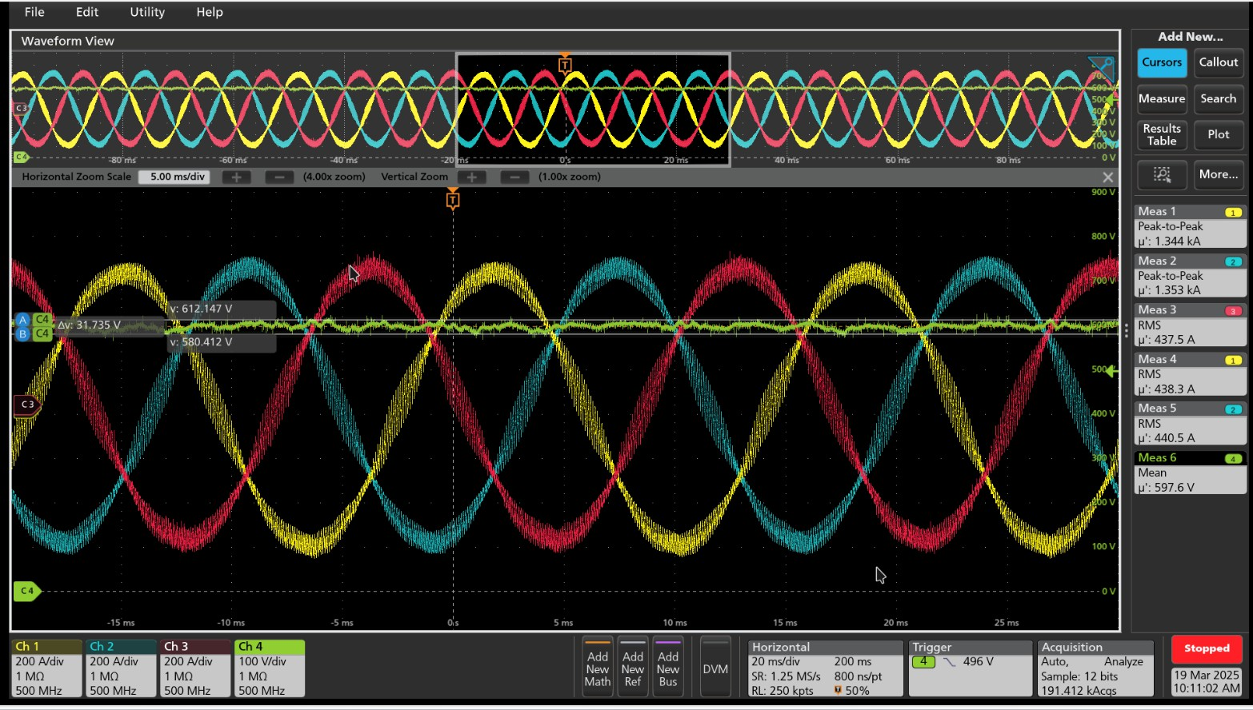
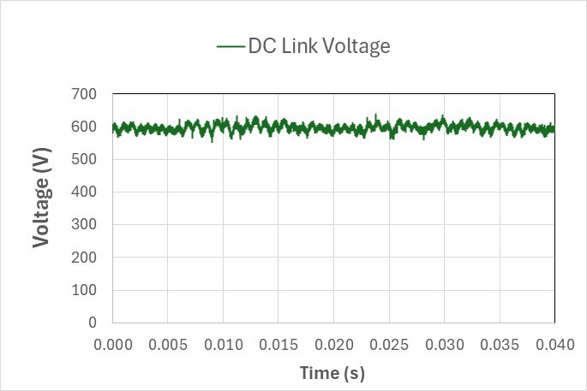
Power Quality Performance Evaluation
POWER & MOBILITY
UUT operating at 350 kW and connected to 60 Hz grid.
UUT commanded to regulate dc link at 600 Vdc.
The measured average voltage is 597.4 V which is -0.4% below reference value which is within +/- 35V specs.
Fig. 9: DC Link Voltage and UUT output ac currents at 350kW load.
Fig. 10: DC link voltage – steady state at 350 kW load.
DISTRIBUTION STATEMENT A. Approved for public release; distribution is unlimited. OPSEC #10906

Slide 11
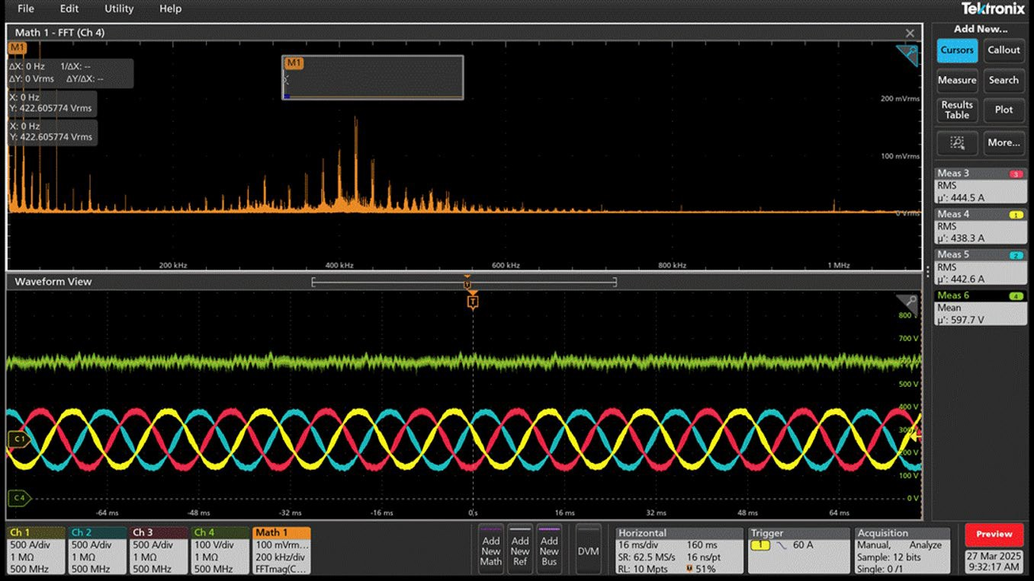
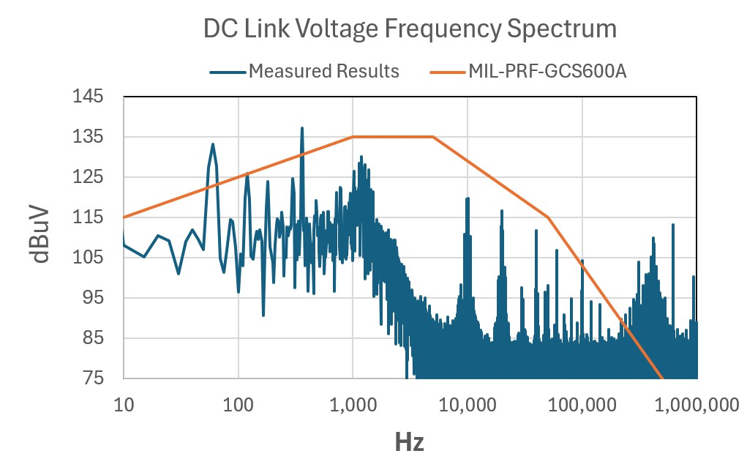
Power Quality Performance Evaluation
POWER & MOBILITY
Frequency spectrum evaluation
Fig.11: DC link | voltage with | its | FFT and | UUT | output ac currents at | Fig. 12: DC link voltage frequency spectrum at 350 kW load and
350kW load. |  |  |  |  |  | the requirement based on MIL-PRF-GCS600A.
DISTRIBUTION STATEMENT A. Approved for public release; distribution is unlimited. OPSEC #10906

Slide 12
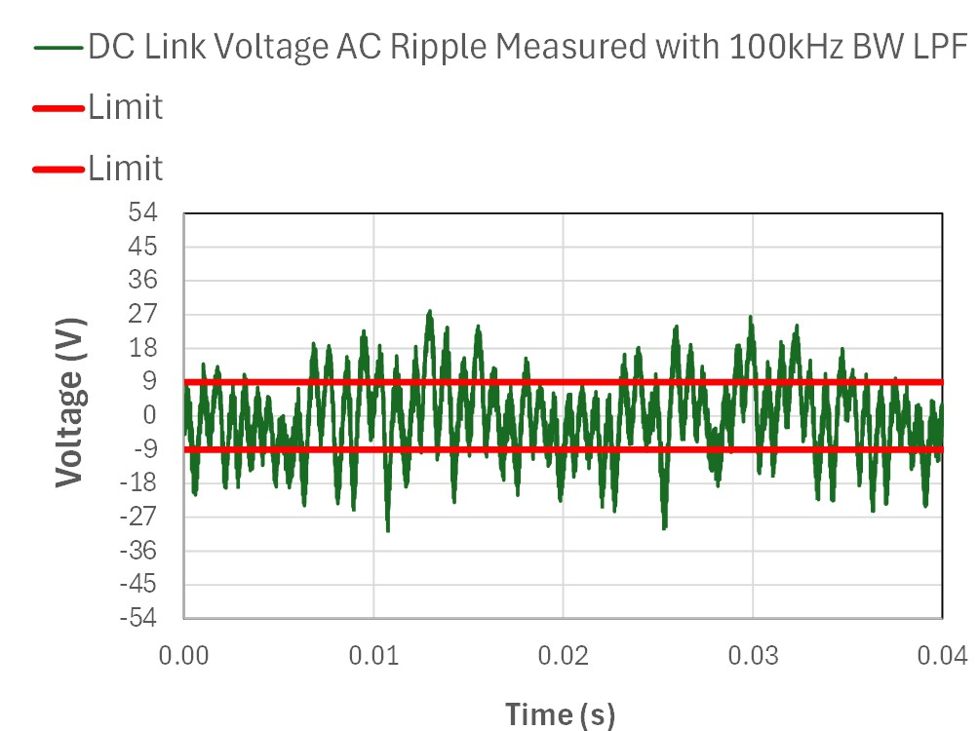
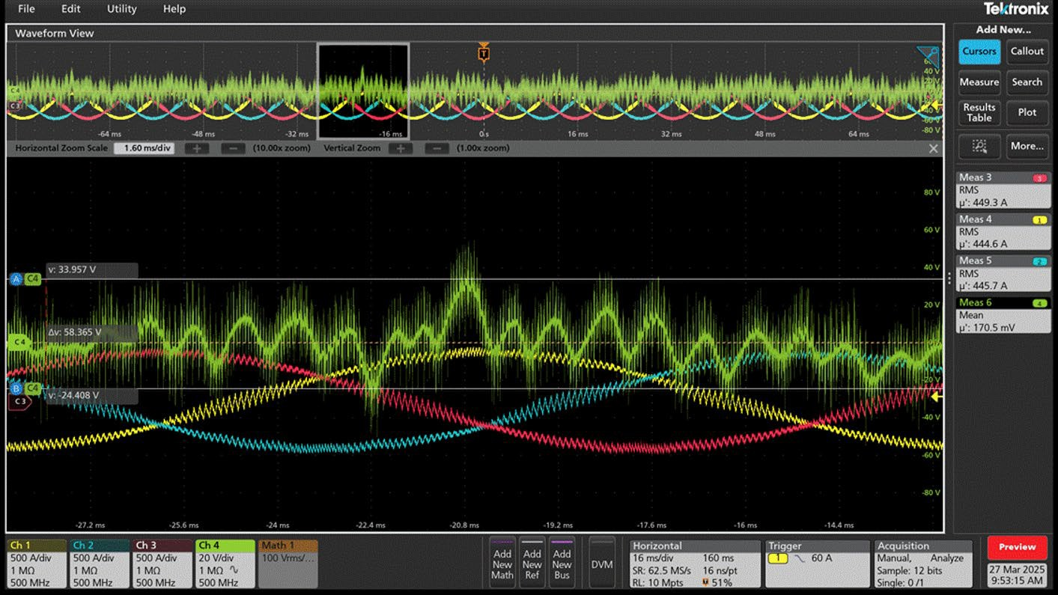
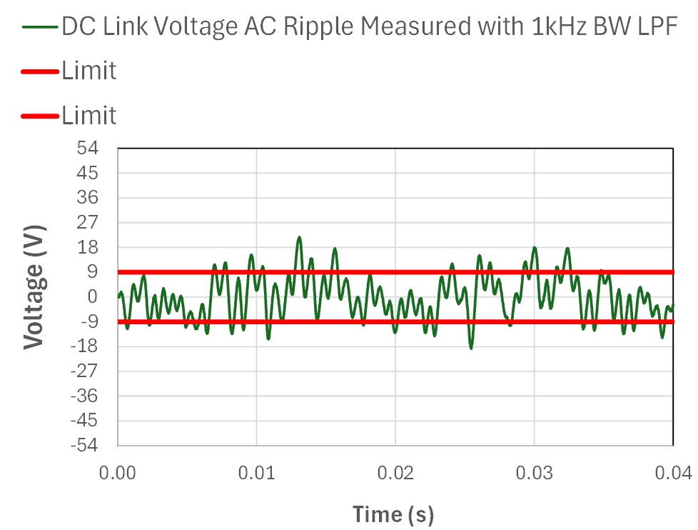
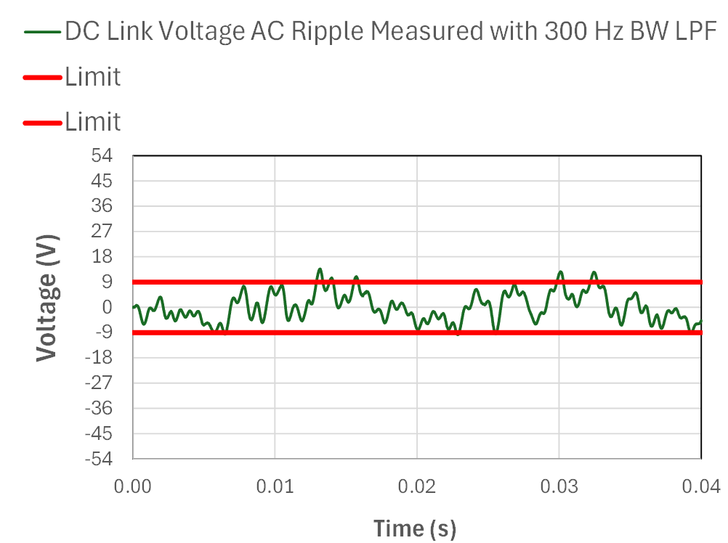
Power Quality Performance Evaluation
POWER & MOBILITY
DC link voltage ripple evaluation
Fig. 14: DC link voltage steady state ac ripple measured with 100 kHz BW LPF at 350 kW load.
Fig. 13: DC Link Voltage and UUT output ac currents at 350kW load.
Fig. 15: DC link voltage steady state ac ripple measured with 1 kHz BW LPF at 350 kW load.
Fig. 16: DC link voltage steady state ac ripple measured with 300 Hz BW LPF at 350 kW load.
DISTRIBUTION STATEMENT A. Approved for public release; distribution is unlimited. OPSEC #10906

Slide 13
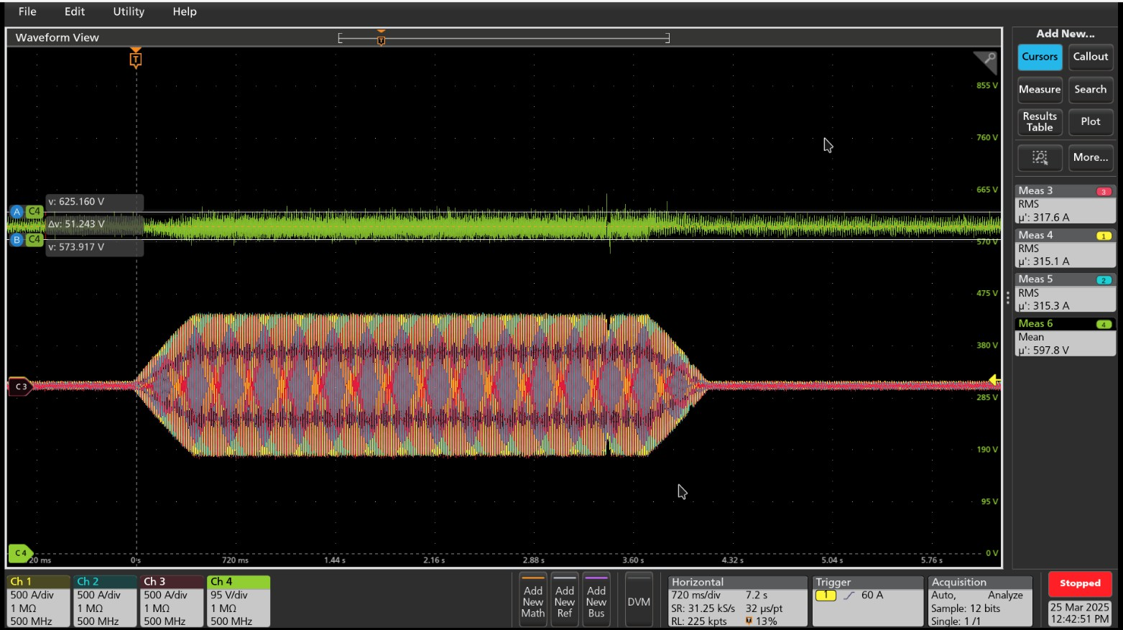
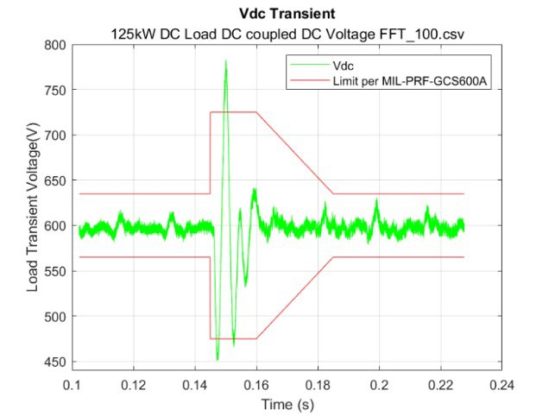
Power Quality Performance Evaluation
POWER & MOBILITY
Step load transient and load ramp up and down
Fig. 17: DC link voltage transient response with ramping up and down 350 kW load (350kW/s).
Fig. 18: DC link voltage transient response with 125 kW dc step load.
DISTRIBUTION STATEMENT A. Approved for public release; distribution is unlimited. OPSEC #10906

Slide 14
Conclusion and Future Work
POWER & MOBILITY
Power quality performance evaluation based on MIL-PRF-GCS600A for 600 Vdc system.
Tests were conducted at 350 kW steady state and 125 kW load transient.
Results confirmed that the DC-1000 Inverter is capable of regulating dc link voltage at 597.4 V (average voltage).
The UUT was capable of regulating the dc voltage back to its reference value at 600 V within 15 ms after 125 kW step load is applied at dc link.
–Over- and under-shoot response needs further tuning of voltage and current control loops (Kp and Ki parameters).
The measured DF is 0.029 (requirement= 0.015). However, the DF from 1.23 kHz to 1 MHz is
0.014 meeting the requirements.
–This confirms that better tuning of voltage and current control loops (Kp and Ki parameters) could help to reduce DF, especially at 60 Hz and 360 Hz.
The results revealed that further filtering needs to be implemented at dc link to attenuate the voltage ripple at frequency range above 250 kHz (beyond the control bandwidth).
DISTRIBUTION STATEMENT A. Approved for public release; distribution is unlimited. OPSEC #10906

